Slide 1


Accelerating Approximate Triangle Counting in Sparse Graphs
EE451: Project Presentation
University of Southern California
Team: Neelesh Gupta, Prasanna Akolkar

Slide 2
Outline
Introduction
Algorithms
Hypothesis
Experiments
Results
Conclusion

Slide 3
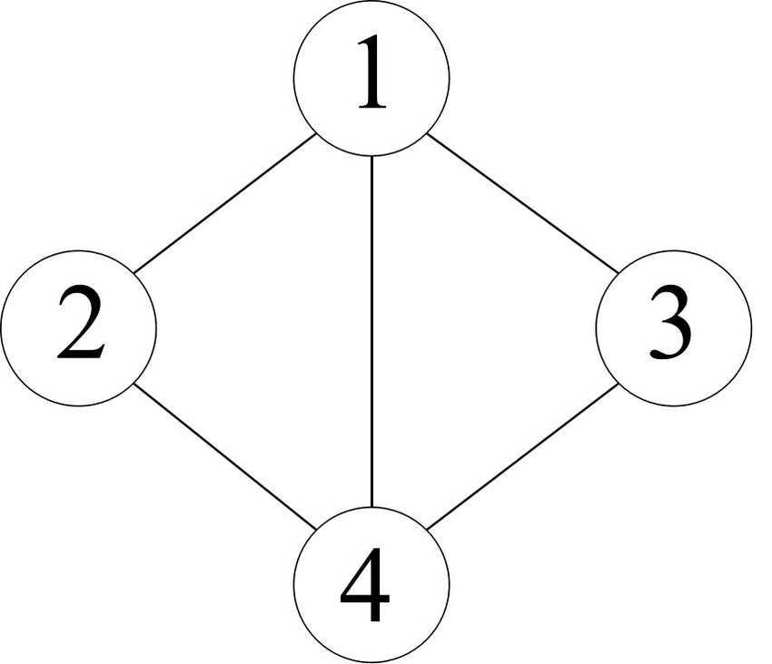
Introduction: What is triangle counting (TC) ?
Applications which require executing TC:
Metrics: clustering coefficient & transitivity ratio
Graph mining: spam detection, community detection, finding common topics
Given an undirected unweighted graph G = (V, E), we want to count the number of triangles where a triangle is three nodes connected together with three edges.
Let G =
Then, TC(G) = 2.
Notes:
Mention application of TC how it gives structure and connectedness of graphs

Slide 4
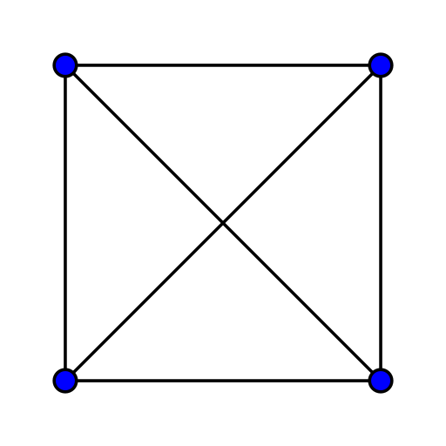
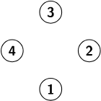

Introduction: Sparsity
K₄
All isolated
Given G = (V, E), let D be density = num. edges / total possible edges.
Sparse graphs typically contain fewer triangles. Hence, recent approaches for even exact triangle counting try to avoid iterating on sparsely connected regions.

Slide 5
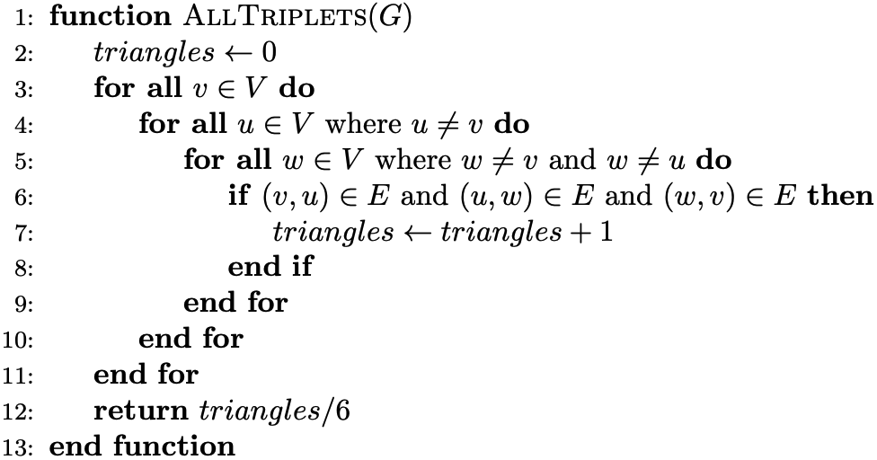
Algorithms: Naive All-Triplets for Exact Triangle Counting
Runtime is O(|V|³) for any graph G.

Slide 6
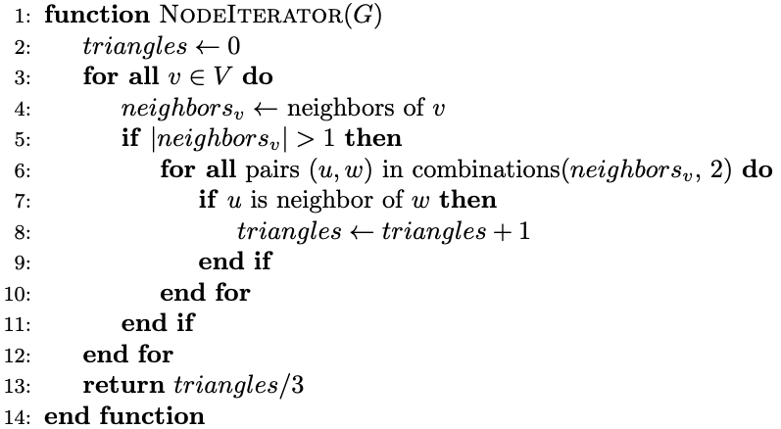
Algorithms: Node-Iterator for Exact Triangle Counting
Average runtime is O(|V|*d²) where d is the average degree for all v in V.
If G connected, d=|V|, so runtime → O(|V|³) as graph becomes more dense.

Slide 7
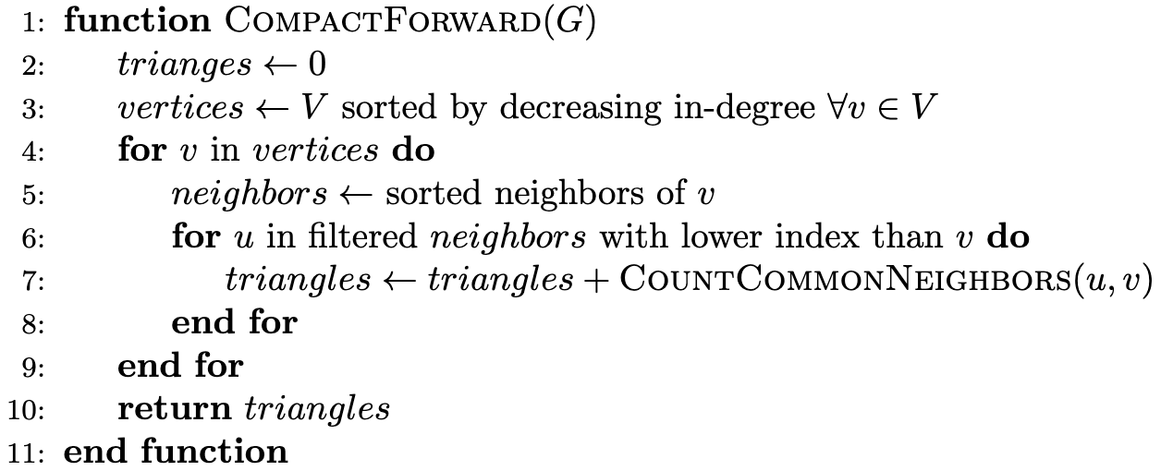
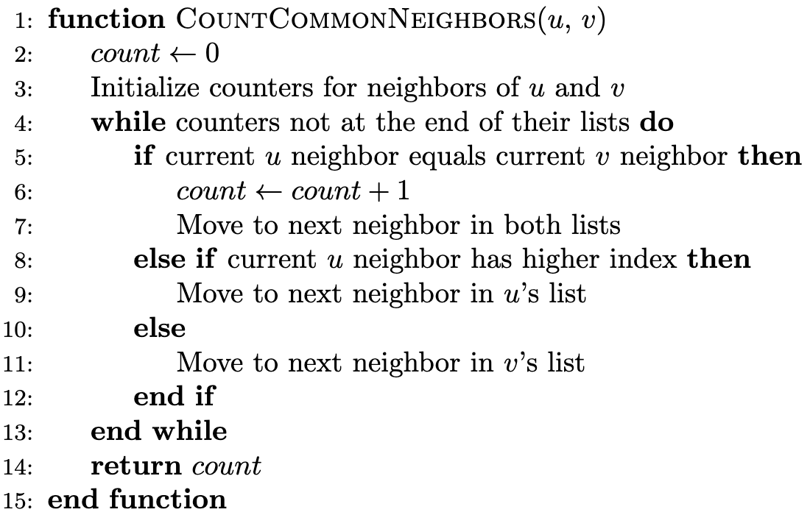
Algorithms: Compact-Forward for Exact Triangle Counting
Average runtime is O(|V|log|V|+|V|d²) b/c we sort |V| nodes and ∀ v∈V, we iterate over d neighbors to intersect in O(d) time.
If G connected, runtime → O(|V|³+|V|log|V|)

Slide 8
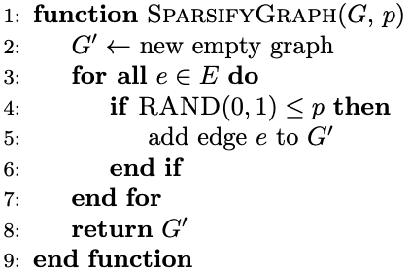
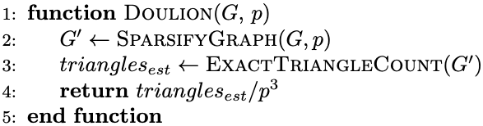
Algorithms: Doulion for Approximate Triangle Counting
Given density D and average degree d of G and percent edges sparsified p, sparsifying G to G’ gives density D’ = p*D and average degree d’ = p*d.
Runtime is O(|E| + runtime of ExactTriangleCount)
For Node-Iterator, O(|E|+|V|(d’)²).
For Compact-Forward, O(|E|+|V|log|V|+|V|(d’)²).
Notes:
Doulin (KDD ‘09)

Slide 9
Hypothesis
Given a sparse graph G = (V, E), the approximate triangle counting approach with percent edges sparsified p
reduces execution time as p → 0; and
returns closer estimates to exact TC(G) as p → 1.
Edge sparsification introduces a tradeoff between TC accuracy and time.

Slide 10
Experiments:
Operating System: Linux Mint 21.1 Cinnamon based on Ubuntu 22.04
GPU: Nvidia GeForce RTX 2070 SUPER (8 GB VRAM)
CPU & RAM: AMD Ryzen 7 3700X (8 core, 16 th.) w/ 16 GB DDR4
Algorithms: Compact-Forward on CUDA, Node-Iterator on 1 CPU
Datasets: ak2010, asia_osm, belgium_osm, coAuthorsDBLP, delaunay_n13, delaunay_n21, delaunay_n24, hollywood-2009, kron_g500-logn21, road_central, road_usa
GPU Memory Profiling: CUPTI & NVBench

Slide 11
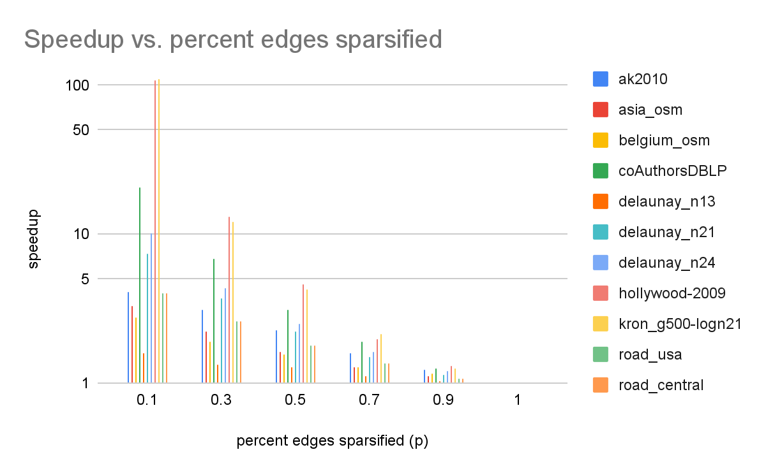
Results: CUDA

Slide 12
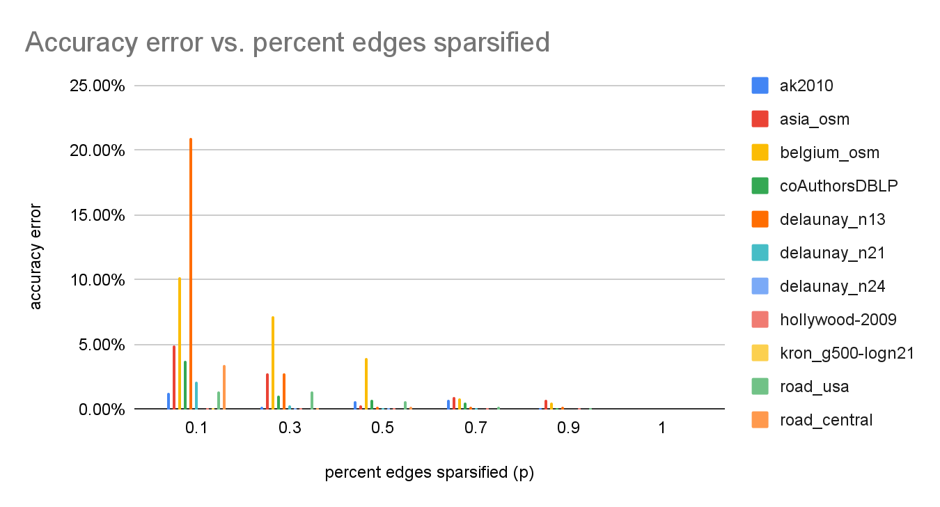
Results: CUDA

Slide 13
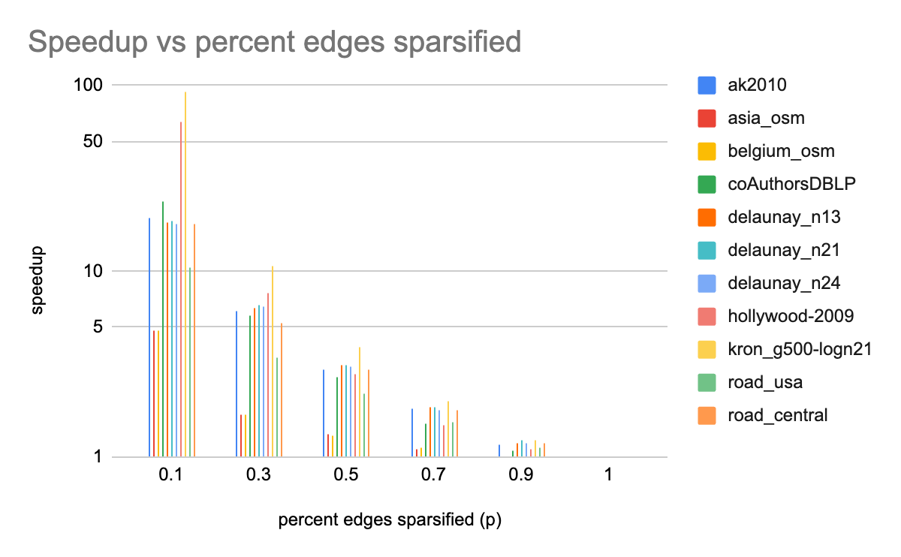
Results: Serial

Slide 14
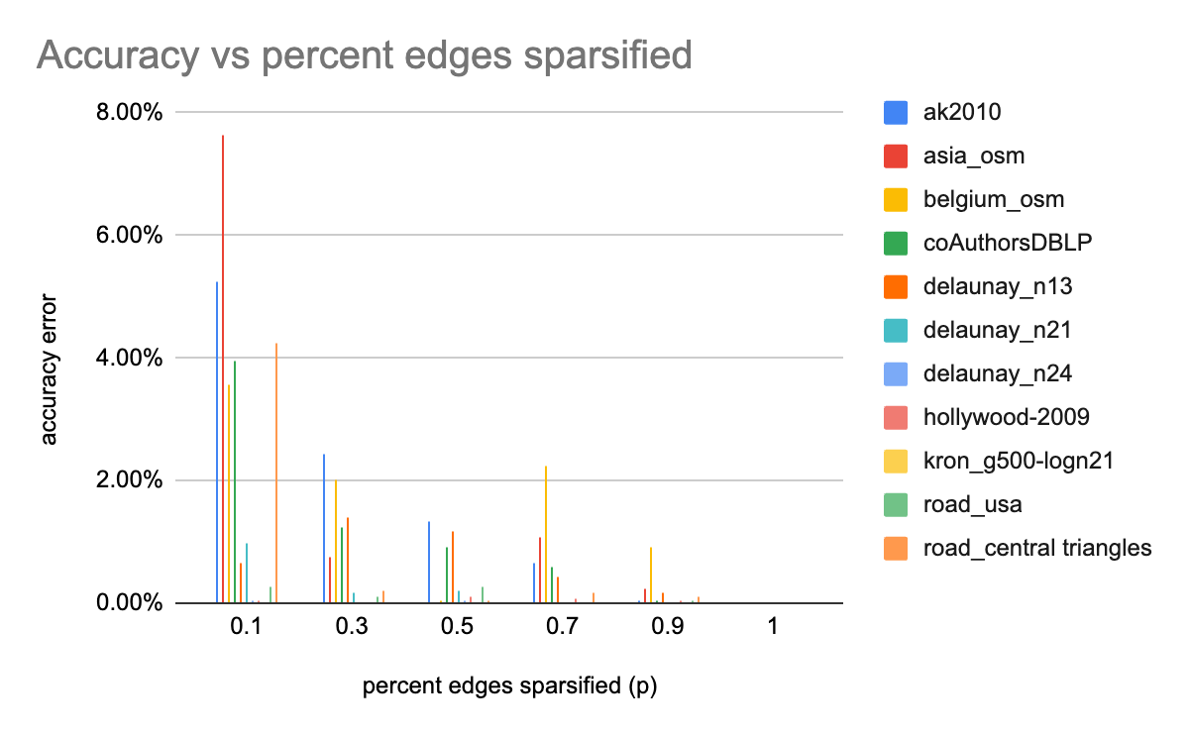
Results: Serial

Slide 15
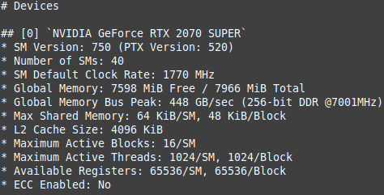
Results: GPU Memory Profiling
 | nodes | edges | density | triangles | triangles per edge | triangles per node
belgium_osm | 1,441,295 | 3,099,940 | 0.000002984542894 | 7260 | 0.002341980813 | 0.005037136742
delaunay_n13 | 8,192 | 49,094 | 0.00146329384 | 49326 | 1.004725628 | 6.021240234

Slide 16
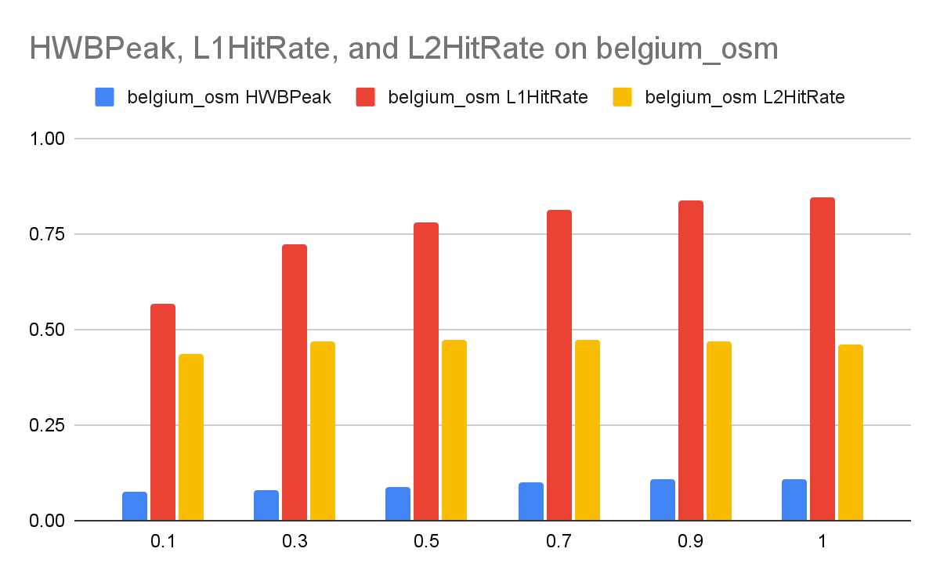
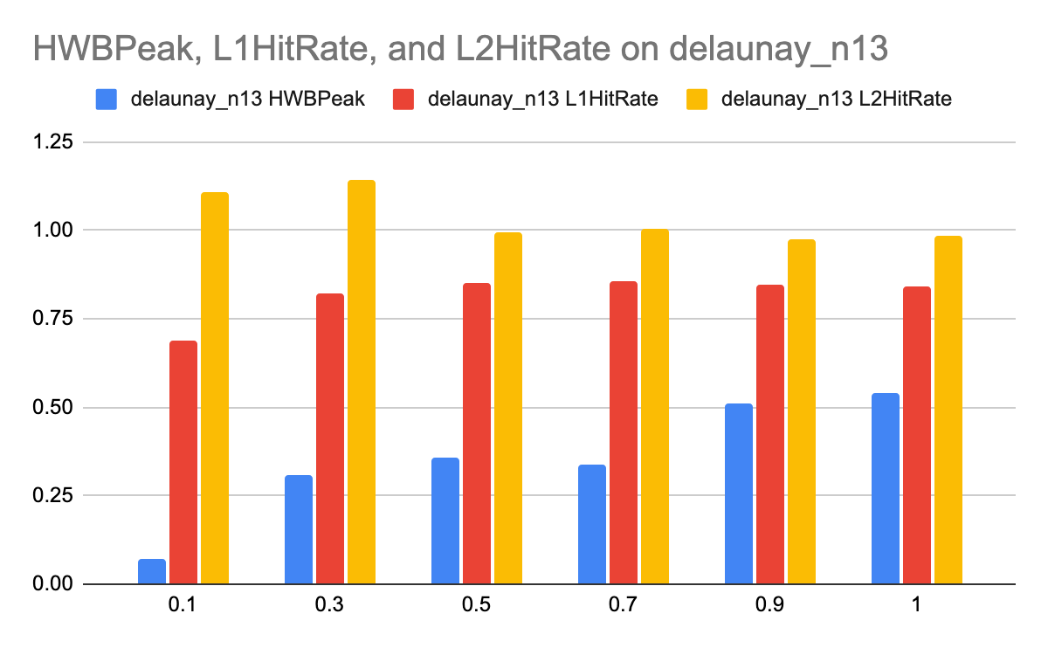
Results: GPU Memory Profiling

Slide 17
Conclusion
In Approximate Triangle Counting, there is a tradeoff observed between accuracy and speedup based on the percent edges sparsified (p).
Furthermore, denser graphs w.r.t. triangles are more amenable to higher p values for a faster and more accurate approximation compared to sparser graphs.
By GPU profiling, we see less cache utilization for sparser input → less GPU util.
Hence, denser graphs are more amenable to approximation for TC.
Github: https://github.com/neeleshg23/TriangleCounting

Slide 18
References:
Wang, Y., Pan, Y., Davidson, A., Wu, Y., Yang, C., Wang, L., Osama, M., Yuan, C., Liu, W., Riffel, A. T., & Owens, J. D. (2017). Gunrock: GPU Graph Analytics. ACM Transactions on Parallel Computing, 4(1), 3:1-3:49. doi: 10.1145/3108140.
Tsourakakis, C.E., Kang, U, Miller, G.L., Faloutsos, C.: Doulion: Counting Triangles in Massive Graphs with a Coin. Proceedings of ACM KDD, 2009

